Slide 1
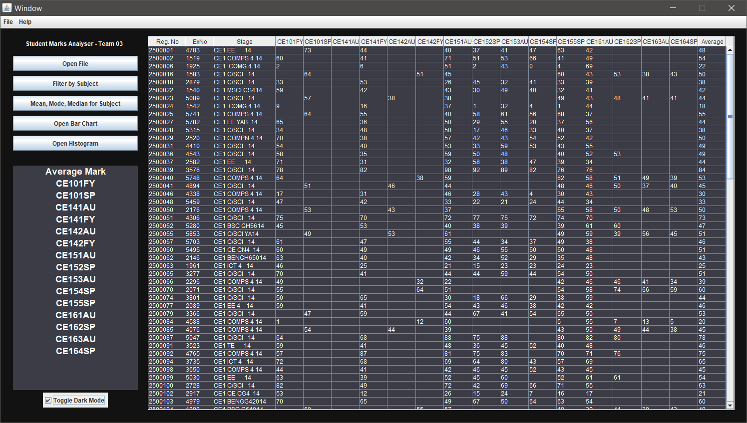
Student Mark Analyser Presentation Team 03 - CE291
Klive Comia Falah Albinfalah
Arpan Patel
Trina Roy
Mohseenur Bashar
Ben Brown
Rakib Siddique
19th March 2020

Slide 2




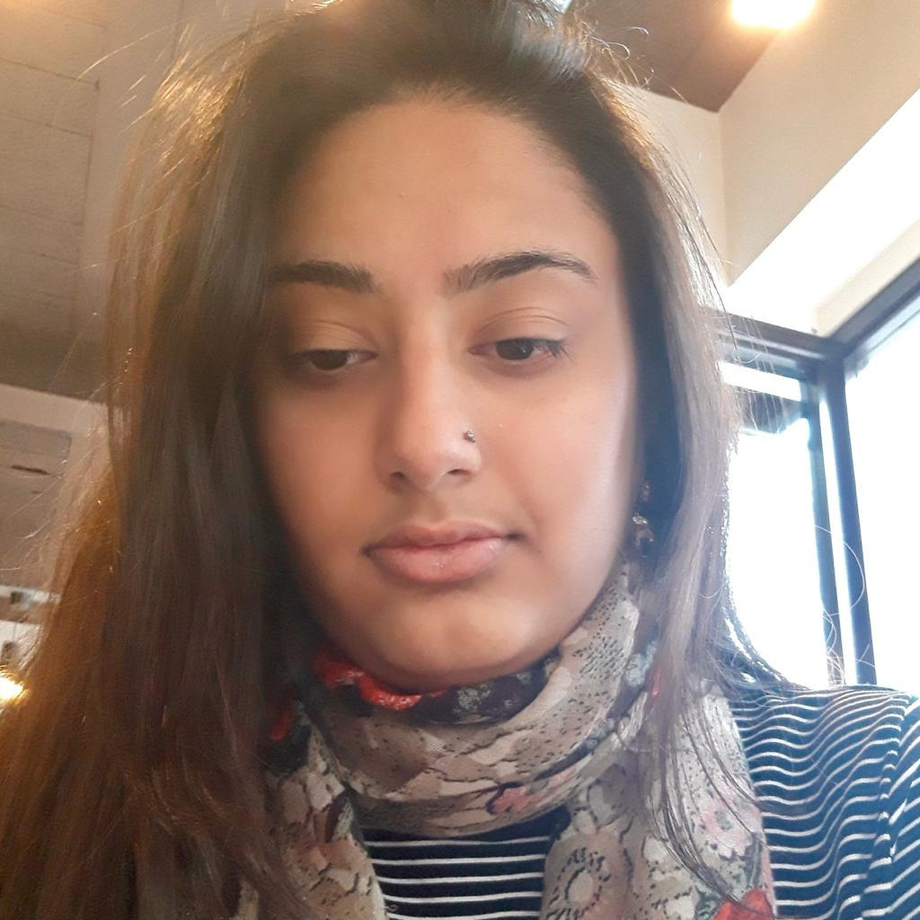

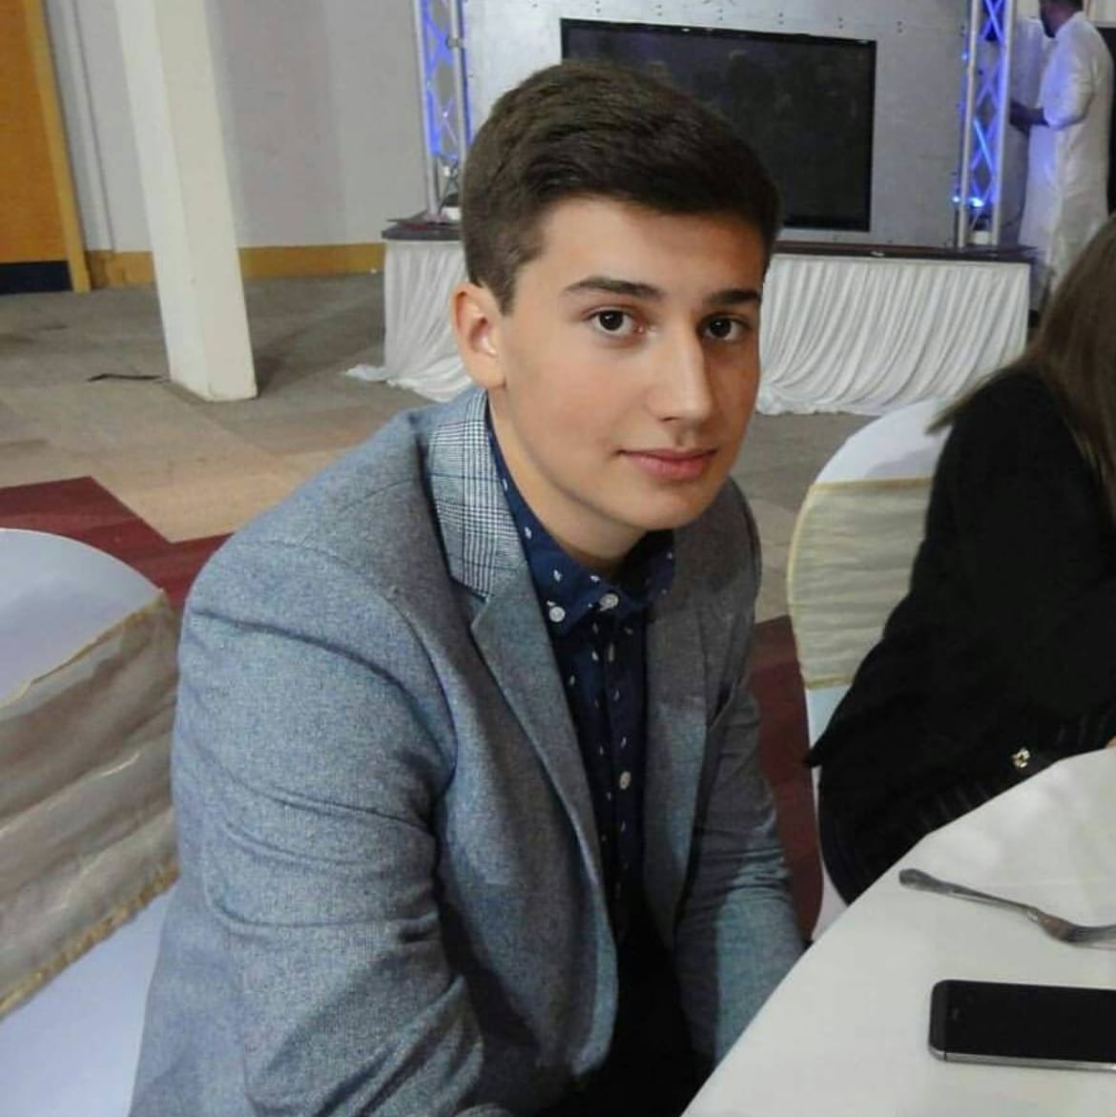
Introduction of the Product & Team
Our product is a Student Marks Analyser built for the EC of the CSEE department at the University of Essex and also Anirban. The Analyser starts by opening an excel file and builds a table which then allows the user to manipulate the data into useable analytics graphs.
Team List & Roles:
Klive Comia - Programmer
Falah Albinfalah - Debugger & Tester
Arpan Patel - Product Testing
Trina Roy - Front End Design
Mohseenur Bashar - Front End Design
Ben Brown - Front End Design
Rakib Siddique - Programmer
Klive
Mohseenur
Falah
Arpan
Trina
Rakib
Meet the Team -
Team 03
Ben

Slide 3
Functions of Analyser
Our product has a number of functions and
features that allow the user to easily use and
monitor student progress:
CSV File Parser and Reader
On Launch and On Button Click
Uses JFileChooser
Ability to Filter Students & Statistical
Analysis by Subject (Mean, Mode, Median)
Allows the User to see Stats for Certain subject
Created with Custom Functions
Graphing Tools to Easily Show Marks
Histogram
Bar Charts
Created with JFreeChart
(spoke to client and said it was accepted)
File Opener Demonstration
Filter Demonstration
Graphing Demonstration
* Slide Features GIFs, open Presentation to view animation.

Slide 4
Functions of Analyser
More Functions:
Export Data to PDF
Uses iText Library
Exports the Data to a PDF
Night Mode
Utilises the Colour Palette
Of JFrame
Useful for those who don’t like
Light themes
File, Help NavBar
Help includes a little tutorial
About to show Team Members
Uses JDialog
PDF Exporting Demonstration
Night Mode Demonstration
NavBar Demonstration
* Slide Features GIFs, open Presentation to view animation.

Slide 5
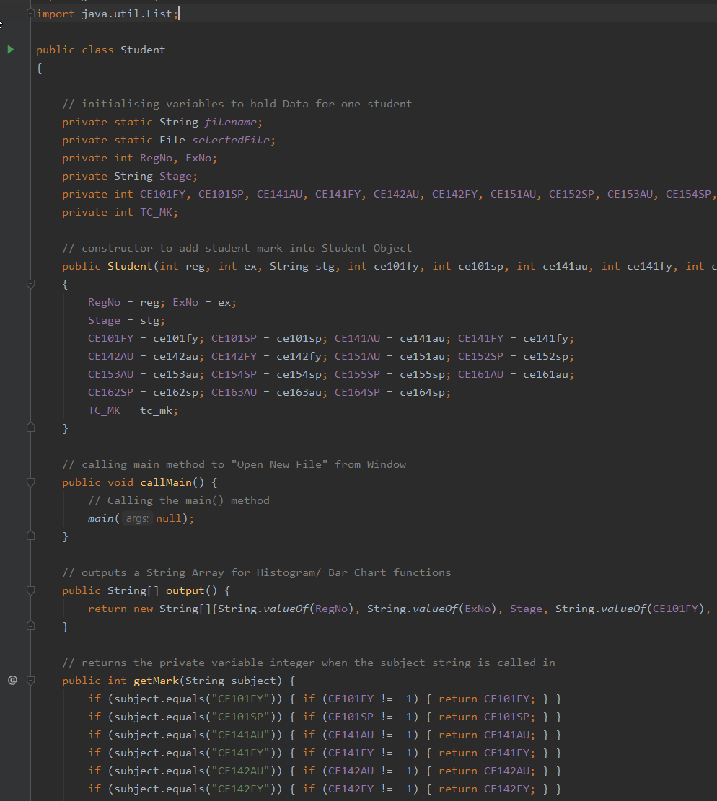
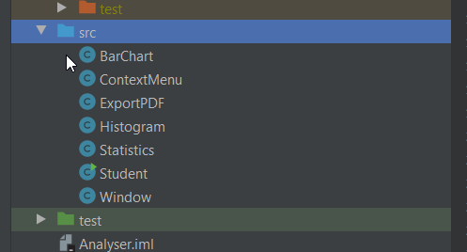
Main Structure of the Product
Analyser v2 is made and runs on Java JDK 1.8
The Analyser Structure is made on a Student
Object. This was created in mind as the CSV
File is structured to have multiple students
in the same file, so running each Student
into a ArrayList to store the data was
the best option at the time.
With this Object in mind, it allowed us to
create our own functions to allow it to return
certain values by using its own variables.

Slide 6
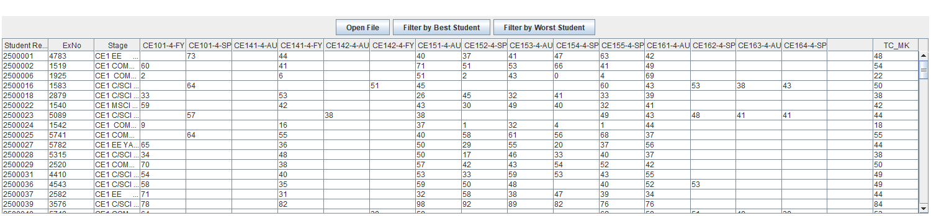
Backend & Frontend Programming - Klive
Klive was one of the main programmers
in the development stage of the Product
He was in charge of the Backend
(Main Program Structure) as well as looking
over the Frontend (GUI and functionality)
of the Production.
In initial production, we had created
Analyser V1, and upon further development,
Klive decided to further improve the Product
with Analyser V2.
Analyser v1
Analyser v2

Slide 7
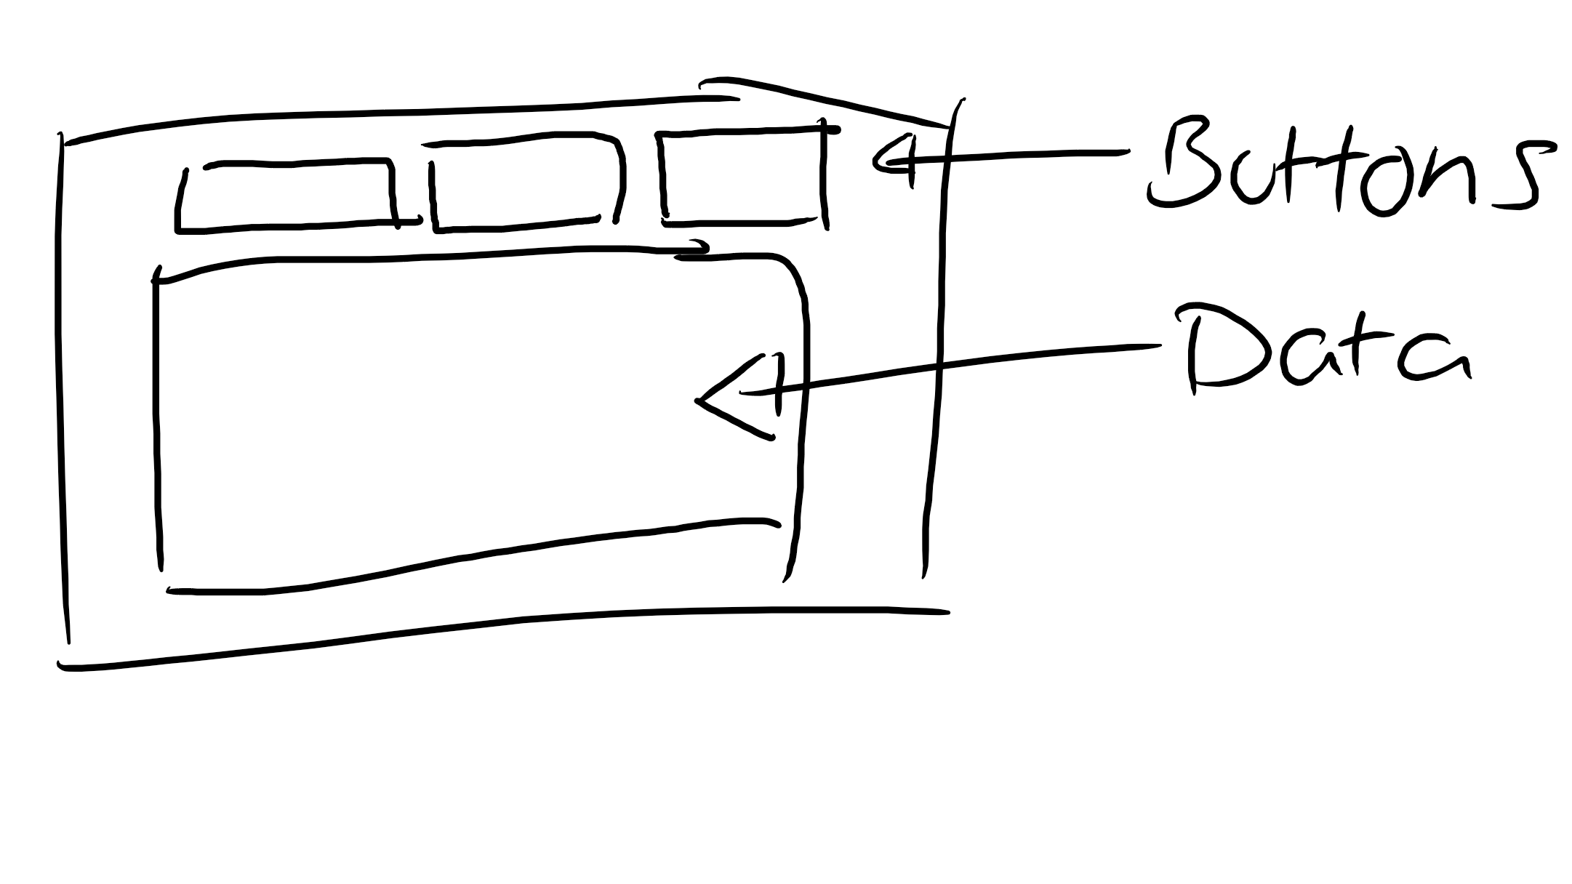
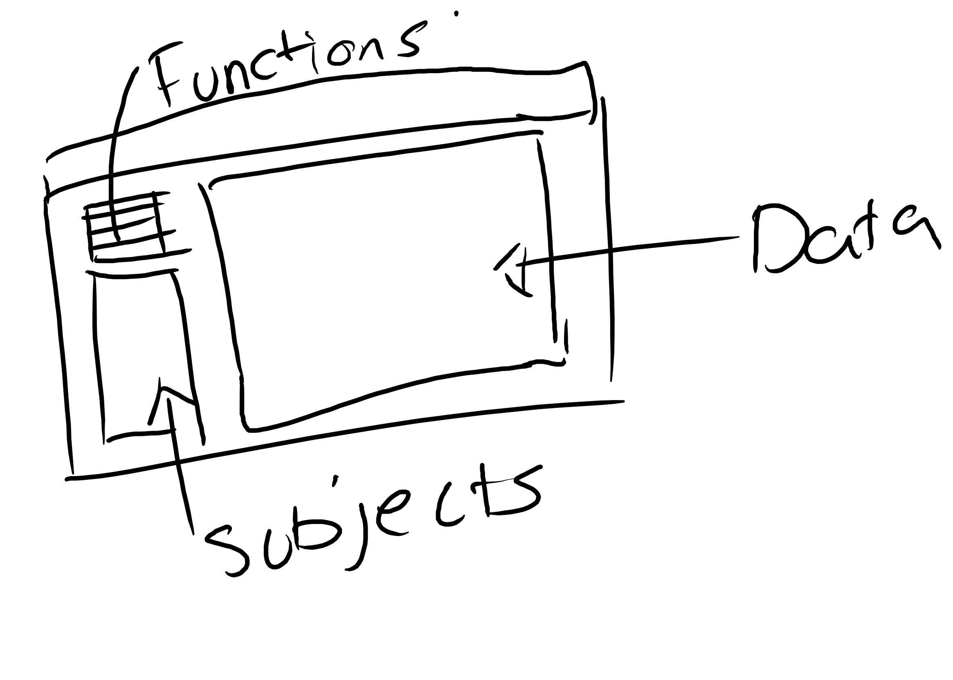
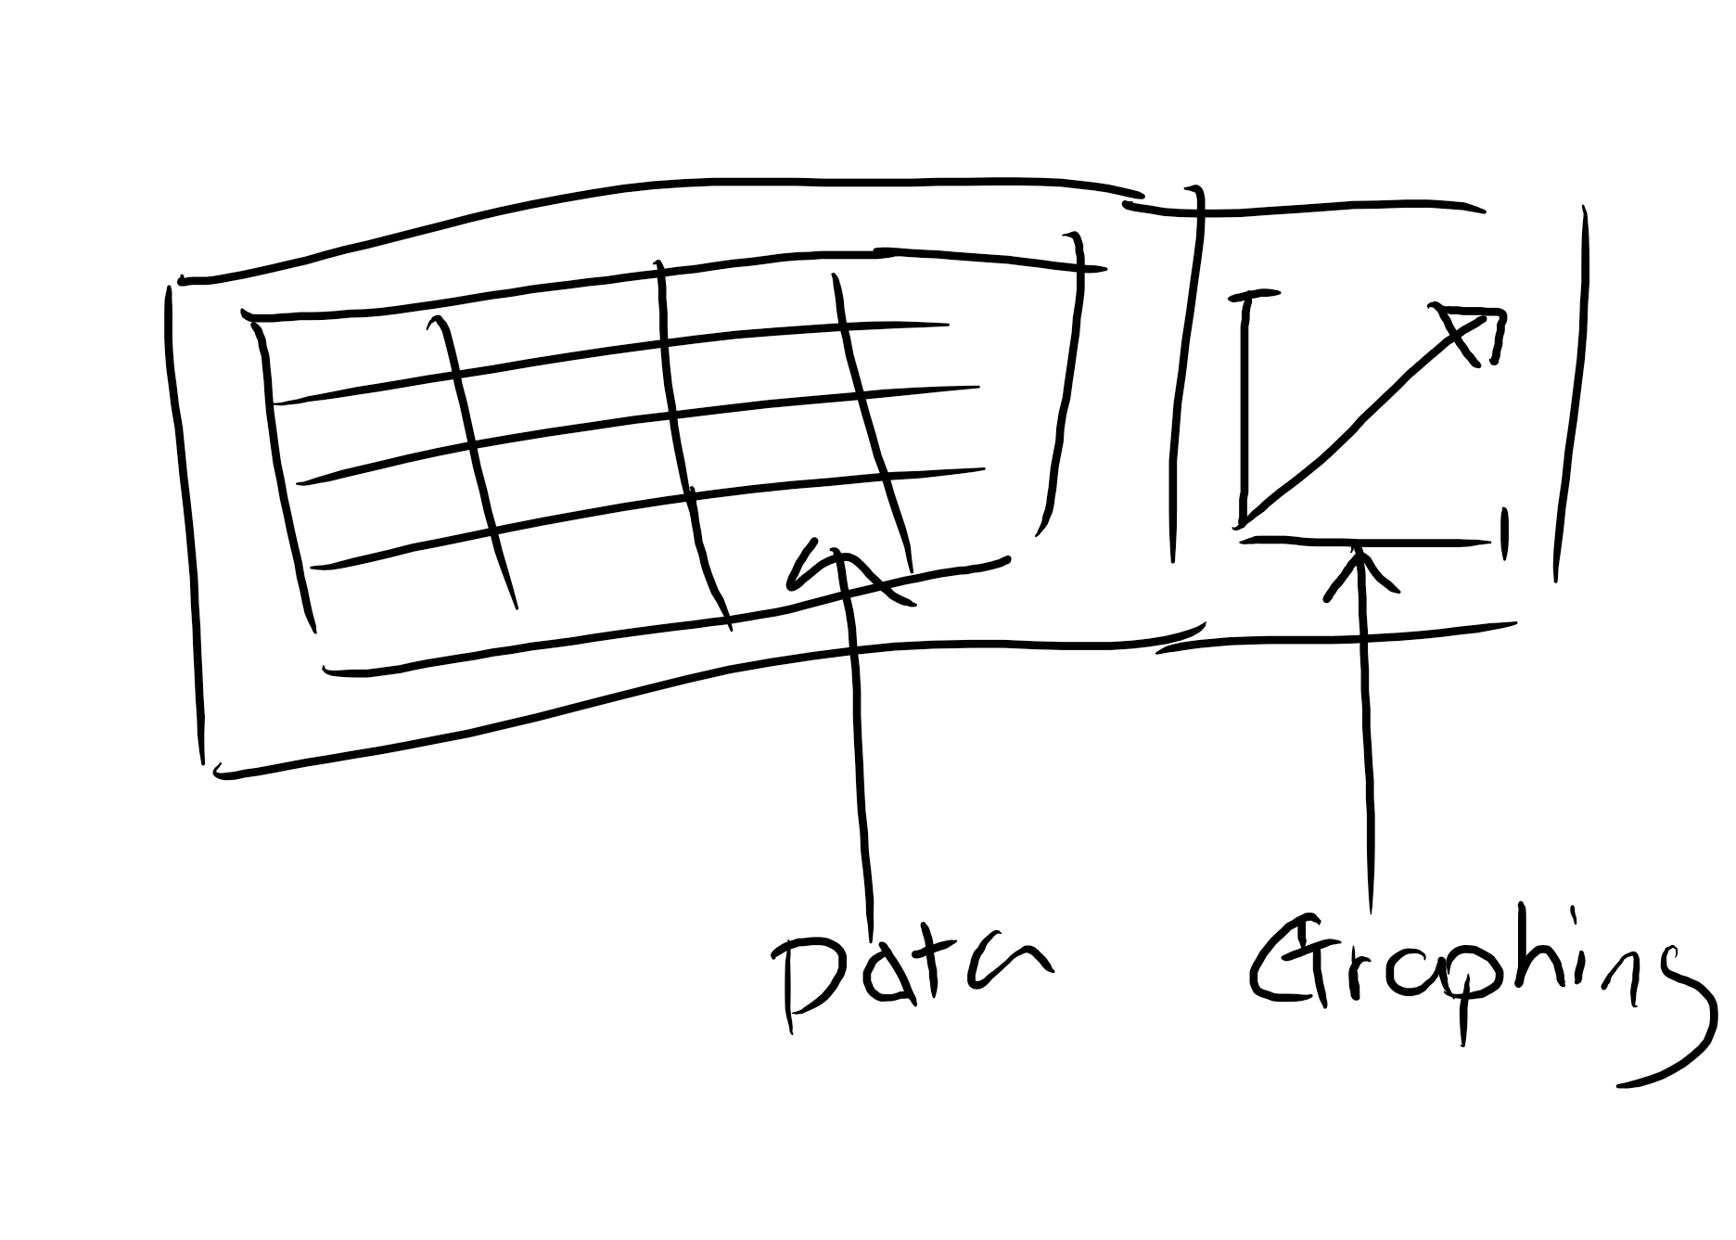
Front End Design - Mohseenur & Ben
In the Front End of Production Mohseenur
and Ben were the main Front End Design members.
We helped klive to sketch and design the front end and UI. We also helped partially in creating, coding and implementing this.
We also helped to contact Klive on all other visual design aspects. Falah helped to debug and help us with smaller issues which were rectified in the final version.
Most of the design were sketched on my Ipad and then converted, ready for use in the final product.

Slide 8
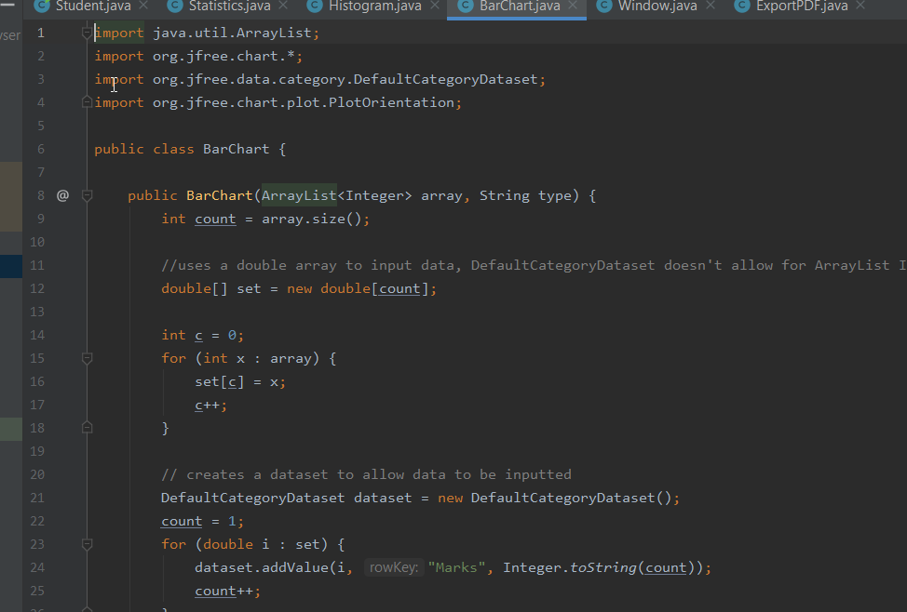
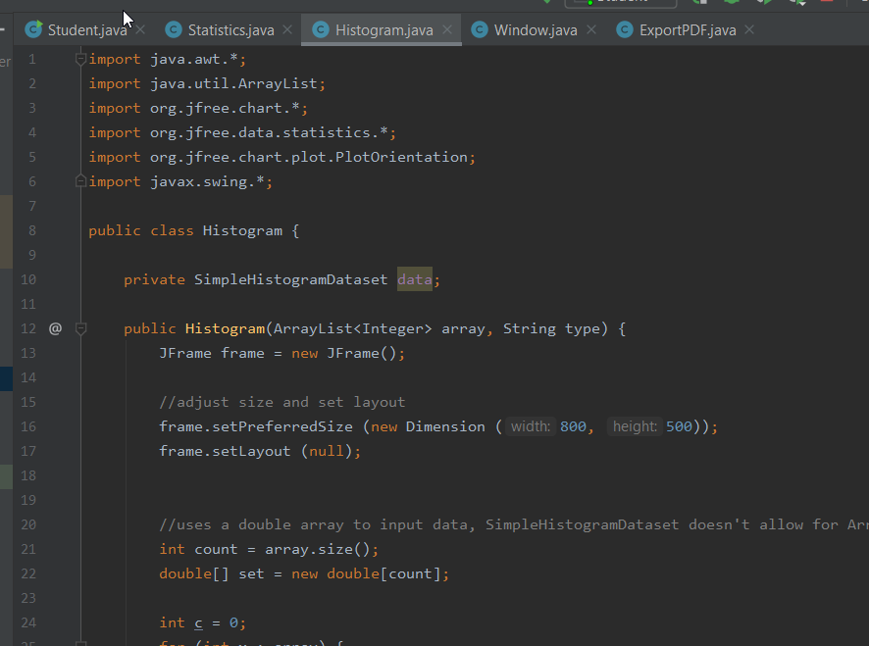
Debugging & Testing - Falah
Falah worked on eliminating errors within the program alongside Klive.
The code and documentation has been efficiently corrected to high standards.
Falah also worked alongside Klive to add input into the design and function of the program, helped with the Graphing Portion of the Program when Klive was struggling.
Helped with Stress Testing the Product
Product has been demonstrated to the customer in an approved form.
Stress Testing Program by using Graphs to see if it will Overload
* Slide Features GIFs, open Presentation to view animation.

Slide 9
Effort Log - Rakib
Sprint 1 {Weeks 17-18)
Scrum Meeting - After checking tasks on moodle, we discussed additional features to add to the product. We also made a start on implementing new features i.e. Graphs.
Sprint 2 (Weeks 19-21)
JUnit testing -Researched how to create JUnit tests and then implemented test classes with no testing functionality.
Sprint 3 (Week 22-23)
Team Effort Log - Started team effort log by organising .md structure to coincide with Jira stories and sub-tasks.
Product Testing Report - Created new tests classes for the updated product using JUnit4.
Sprint 4 (Week 23 P.2)
Sprint 5 (Week 23 P.3)
Team Effort Log -Added additional tasks to sprints and updated team effort log.
Product Testing Report -Increase coverage of test classes.

Slide 10
Effort Log - Falah
Sprint 1 {Weeks 17-18)
Scrum Meeting -Meeting has made the team explore potential ways on how to approach completing the project. Took 1 hour.
Sprint 2 (Weeks 19-21)
Debug Code -Test code and check for errors. Took 3 hours. Week 20 Scrum
Sprint 3 (Week 22-23)
Program Final Debugging - Correcting and finalizing the code for the presentation and submission. Took 4 hours.
Product Context Report - Exploring the legal, ethical and health & safety aspects of the program. Discussing details of the copyrights and intent of use. Took 1 hour.
Sprint 4 (Week 23 P.2)
Sprint 5 (Week 23 P.3)
Presentation Slides- Creating a powerpoint presentation for the final demonstration of the product. Took 3 hours.

Slide 11
Effort Log - Klive
Sprint 1 {Weeks 17-18)
Scrum Meeting -We had caught up with eachother after the holidays to make sure everyone is doing okay, ensuring that we have a game plan for the program ahead. We decided that We will probably redo the product - with cleaner code execution. This was met with great success and a more optimised product (Following Object Oriented Programming) Design Front-end -This was a long task, I had to catch up with Ben and Mohseenur with this task - I was working with the Programming side and wanted to create a new GUI Optimise product -I had to optimise the product (Analyser v2)
Sprint 2 (Weeks 19-21)
Week 20 Scrum -Discussed additional features such as a Line Graph feature. We also spoke of starting to implement JUnit testing.
Sprint 3 (Week 22-23)
Project Management Log -Made start on the team management section of the final report.
Sprint 4 (Week 23 P.2)
Project Management Log - Finished the team management section of the final report.
Sprint 5 (Week 23 P.3)
README File - Updated README file on how to run program.

Slide 12
Effort Log - Ben
Sprint 1 {Weeks 17-18)
Scrum Meeting Front-end Research -Research GUI designs. Send designs to Mohseenur.
Sprint 2 (Weeks 19-21)
Week 20 Scrum -Discussed additional features such as a Line Graph feature. We also spoke of starting to implement JUnit testing.
Sprint 3 (Week 22-23)
Project Management Log -Made start on the team management section of the final report.
Sprint 4 (Week 23 P.2)
Project Management Log - Finished the team management section of the final report.
Sprint 5 (Week 23 P.3)
README File - Updated README file on how to run program.

Slide 13
Effort Log - Trina
Sprint 1 {Weeks 17-18)
Scrum Meeting -Had a meeting and talked on what needs to be done, later on creating the tasks:
Catch-up with members
Check tasks on Moodle
Work on planning product
Add additional features to product
Create new ideas for product
Create login for product -Creating a login program Design Front-end -Creating the GUI for the login program. Optimise product -Making sure the code is up-to-date and working
Sprint 2 (Weeks 19-21)
Week 20 Scrum -Catching up on work so we are up-to-date
Sprint 3 (Week 22-23) Sprint 4 (Week 23 P.2) Sprint 5 (Week 23 P.3)
Class Diagram -Creating a class diagram from the code

Slide 14
Effort Log - Mohseenur
Sprint 1 {Weeks 17-18)
Scrum Meeting Began to plan the updates for the upcoming changes of the product Length: 2h
Research GUI designs Researched and designed different GUI designs for final product Length: 3d 4h
Sprint 2 (Weeks 19-21)
Week 20 Scrum Discussed implementation of new GUI, additional features such as JUnit testing Length: 3h
Sprint 3 (Week 22-23)
Team Marketing Plan Background research conducted on Team Marketing Plan Length: 3d
Sprint 4 (Week 23 P.2)
Team Marketing Plan Finalised updates for Team Marketing Plan Length: 1w
Sprint 5 (Week 23 P.3)
Final Project Report Document Updated and compiled the final Project Report document. Length: 1d

Slide 15
Effort Log - Arpan
Sprint 1 {Weeks 17-18)
Scrum Meeting -We discussed about product with the tutor for future product and what we can add and how we can improve it by adding new features.
Sprint 2 (Weeks 19-21)
JUnit testing - Did research about junit testing and tired to follow the steps. Week 20 Scrum - After making product we discussed on what more we can add i.g. graphs and better layout.
Sprint 3 (Week 22-23)
Team Effort Log - Got this part of report and tried to make it easier for members wrote down all their sprints so they don't have to waste time looking for it as they would just have to write description on what they did. Product Testing Report - After researching aobut junit testing, implemented it by creating new test classes
Sprint 4 (Week 23 P.2) Sprint 5 (Week 23 P.3)
Team Effort Log -Made improvements on the report as we got more sprints uploaded it on git. Product Testing Report -Made improvements on the report as few changes were made to the product

